Slide 1
Creating A Virtual Mail Server
Group 4
CTEC 435-102 Bowie State University
Chinwendu Imegwu, Asher Tadikonda, Heydi Rivera,

Slide 2
Group 4
CTEC 435-102 Bowie State University
Abstract
Initial Setup
Installing and Configuring
MySQL and Postfix
Configuring Postfix for Security
Dovecot Configuration
Spam and Virus Protection
Access Restrictions
Log Monitoring With Pflogsumm

Slide 3
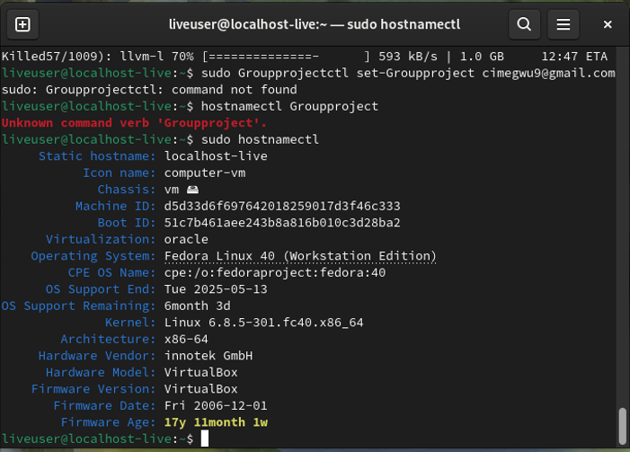
Abstract
Group 4
CTEC 435-102 Bowie State University
Virtual Mail Server
A virtual mail server on Linux lets you set up email easily and securely. You start by choosing a Linux system and installing software like Postfix for sending emails and Dovecot for receiving them. Security is added with encryption and spam filters. User access can be managed through simple methods like local databases or MySQL. You can also add webmail for easy access. This setup gives you a secure and flexible way to manage email.

Slide 4
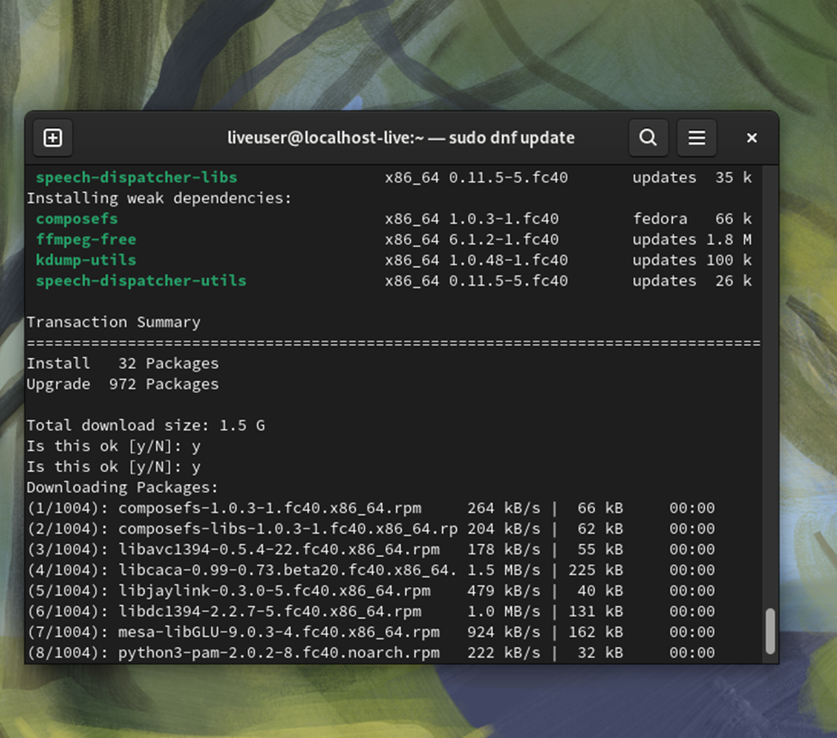
Initial Setup
Group 4
CTEC 435-102 Bowie State University
Outline
Outcome: Server is prepared for the installation of mail server software and communication setup.
Key Takeaway: Proper initial setup is essential; any mistake here can lead to issues down the line, like undelivered emails or server misidentifications.
System Updates and Dependencies: Update system packages to ensure the server is running the latest versions of software, and install necessary dependencies for the mail server setup.
Hostname Configuration: Set the server hostname to match the mail domain (e.g., mail.example.com).
DNS Configuration: Ensure proper DNS records (MX and A records) are configured for email traffic routing.

Slide 5
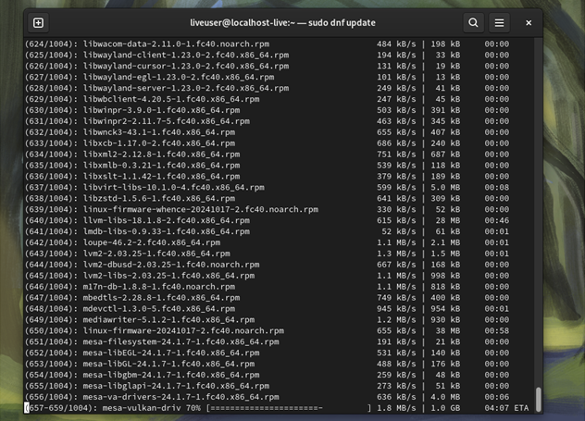
Installing and Configuring Software Packages
Group 4
CTEC 435-102 Bowie State University
Core Software Installed
Postfix: Install Postfix as the MTA to send and receive emails.
Dovecot: Install Dovecot to enable email retrieval via IMAP/POP3.
MySQL: Install MySQL to manage user authentication and virtual domains.
Amavis and ClamAV: Install Amavis for virus scanning and ClamAV for additional protection.
Outcome: Essential mail server software is installed and ready for configuration.
Key Takeaway: Always verify package versions and dependencies before installation to avoid conflicts. Having a clear understanding of each software’s role in the ecosystem made the process smoother.

Slide 6

MySQL & Postfix Integration
Group 4
CTEC 435-102 Bowie State University
Database setup, User Authentication
Create MySQL Database and Tables: Define tables for virtual domains, users, and aliases.
Configure Postfix with MySQL: Set up Postfix to authenticate users and handle email delivery using MySQL lookups.
Postfix Configuration: Ensure Postfix is integrated with MySQL for user management.
Outcome: MySQL is integrated with Postfix for managing virtual domains and users, ensuring email delivery and authentication.
Key Takeaway: Proper database design is critical for smooth integration. Ensuring that Postfix properly interacts with MySQL through correct lookup configurations was key to preventing mail delivery issues.

Slide 7
Configuring Postfix For Security
Group 4
CTEC 435-102 Bowie State University
SMTP Authentication, SMTPS
Postfix Configuration: Use the postconf command to configure Postfix for virtual domains, mappings, and alias lookups from MySQL.
SMTP Authentication: Set up SASLAUTHD to allow secure email submission and prevent unauthorized relays.
Enable SMTPS: Secure email submission by enabling SMTPS on port 465.
Outcome: Secure and authenticated email transmission is set up, enhancing server security.
Key Takeaway: Security is vital. Even small configuration mistakes can lead to vulnerabilities such as unauthorized email relays. It is crucial to test thoroughly to ensure proper encryption and authentication settings.

Slide 8
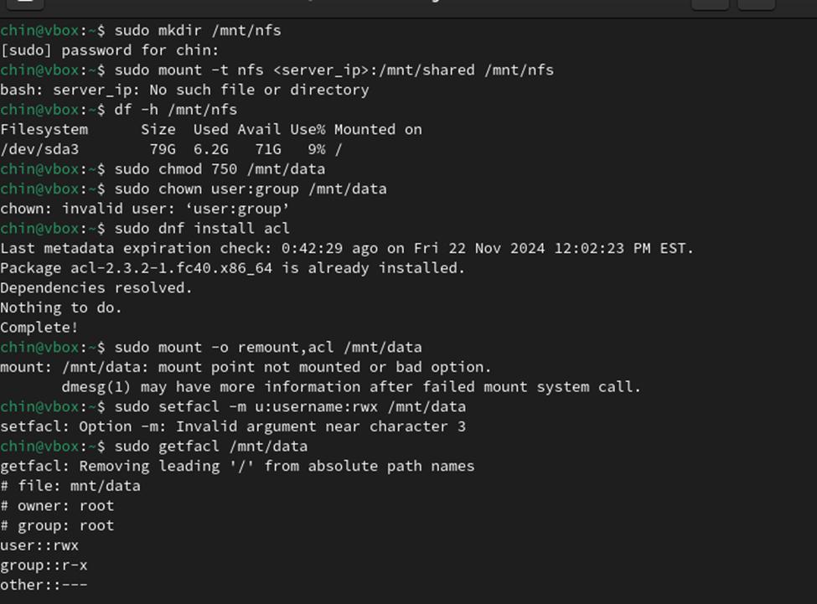
Dovecot Configuration
Group 4
CTEC 435-102 Bowie State University
IMAP/POP3
Dovecot Configuration: Edit Dovecot configuration files to enable IMAP and POP3 services and integrate with MySQL for user authentication.
Test Retrieval: Test email retrieval using mail clients.
Outcome: Email retrieval functionality via IMAP/POP3 is set up, and users can securely access their inboxes.
Key Takeaway: Ensuring a seamless integration between Dovecot and MySQL for authentication is crucial. Additionally, proper testing with mail clients ensures the setup is effective across multiple platforms.

Slide 9
Setting Up Spam and Virus Protection
Group 4
CTEC 435-102 Bowie State University
AMavis, ClamAV, Rspamd
Amavis + ClamAV: Configure Amavis to scan emails using ClamAV for viruses.
Rspamd: Set up Rspamd for advanced spam filtering.
Testing: Send test emails containing spam and viruses to ensure the system detects and handles them.
Outcome: Enhanced spam and virus protection to ensure secure email communication.
Key Takeaway: Finding the right balance in spam filtering is critical. Too aggressive a filter can block legitimate emails, while too lenient a filter can let spam through. Thorough testing with various types of emails is essential.

Slide 10
Access Restrictions in Postfix
Group 4
CTEC 435-102 Bowie State University
Access Restrictions to Fight Against Spam
Postfix Access Policies: Configure access restrictions for sending and receiving emails, blocking unauthorized sources.
Sender/Recipient Restrictions: Implement HELO, recipient, and sender restrictions to prevent spam.
Outcome: Only authorized users or trusted IP ranges can send and receive emails, helping fight against spam.
Key Takeaway: Carefully managing access restrictions helps mitigate the risk of email abuse. It’s crucial to test configurations with different sender/recipient combinations to ensure proper functioning.

Slide 11
Log Monitoring With Pflogsumm
Group 4
CTEC 435-102 Bowie State University
PostFix Log Monitoring
Install Pflogsumm: Set up Pflogsumm to analyze Postfix logs for email traffic and errors.
Generate Reports: Generate and review logs for suspicious activities and server misconfigurations.
Outcome: Proactive server monitoring is in place to ensure smooth operation and detect issues.
Key Takeaway: Log analysis is an indispensable tool for ongoing server management. Regular log monitoring helps detect problems early, ensuring the server runs smoothly and securely.

Slide 12
Lessons Learned
Group 4
CTEC 435-102 Bowie State University
Challenges, Solutions, Key Takeaways
Overall Experience: The project highlighted the importance of troubleshooting and understanding the interdependencies of various software components. Collaboration, good documentation, and proactive testing were key to overcoming challenges. It also became clear how crucial it is to approach mail server setup with a focus on security, as improper configurations could lead to vulnerabilities.
Key Takeaway: Managing a mail server requires a combination of technical knowledge, attention to detail, and rigorous testing. Each component of the system needs to be carefully integrated and monitored to ensure a reliable and secure service.

